Slide 1
Productionizing ML Models Speakers Paranth Thiruvengadam Karthik Karunanithi.

Slide 2
What does Data Scientist do today?

Slide 3
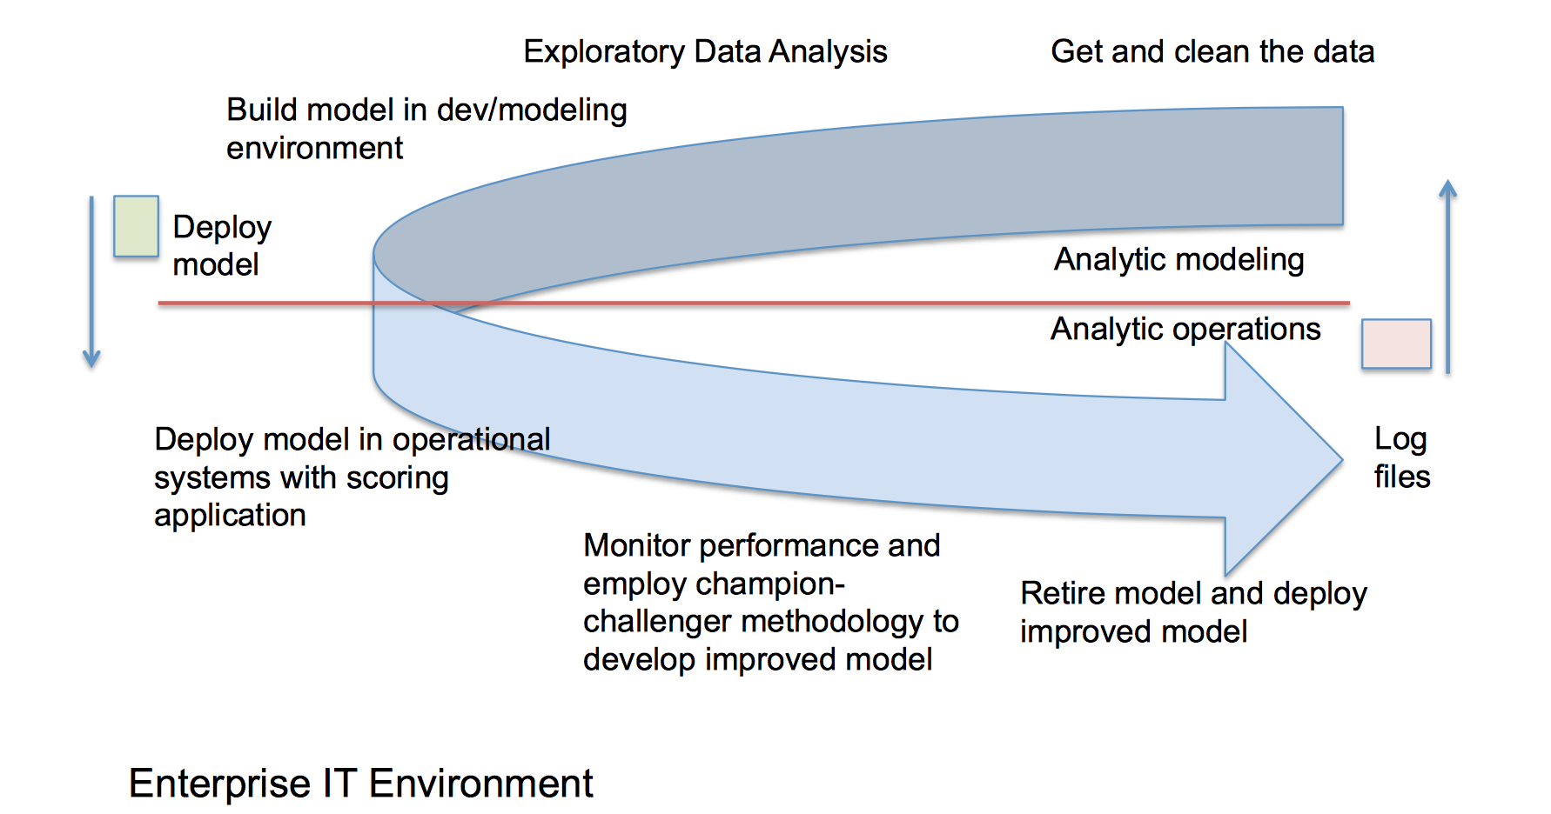
Lifecycle of a Model

Slide 4
Do we need a Model Interchange format?
Many Model Producer and single Model Consumer
Spark
JSON
Python
Pickle
R
Serialization/JSON

Slide 5
Why not PMML?
Extensibility
Only Model specified in PMML standard can be deployed.
Pre-Post Processing Hooks.

Slide 6
What is PFA (Portable Format for Analytics)
Independent of specific tools, application or systems.
Analytic model can be implemented plus data transformation and aggregation required for pre and post-processing data.
For Filter/aggregate option
PFA has methods like map, emit, and fold,
Sample PFA Code
input: double
output: double
action: - {m.round: {"*": [{m.sin: {+: [input, 1]}}, 2]}}

Slide 7
Benefits of PFA
Extensible Language – for defining models + pre and post processing code
Allow Model Composition – support Chain/Hierarchy of Models.
Any Model that is specified in the PFA language can be deployed.
“Safe” to deploy in IT operational environment.
Hadrian – PFA compliant JVM based scoring engine
Aurelius and Titus APIs for converting from R and Python to PFA.

Slide 8
Demos
Standard algorithm in scikit learn converted to PFA
Customized algorithm converted to PFA
A/B Testing of Models

Slide 9
Q&A

